Slide 1
NERS 551 Nuclear Reactor Dynamics Winter, 2021 Lecture 9: Chapter 8 February 3, 2021 Prof. T. Downar

Slide 3
“Big Picture”
Ch 5 Exact Point Kinetics (Eq. Eq. 5.34)
w/ assumptions -> Point Reactor Model
Ch 6
Simplify Delayed Neutron Source -> one group delayed neutrons
Application to CONSTANT reactivity insertion (ie NO FEEDBACK)
SOLUTION w/ one group delayed neutronics … Eq. 6.109
Superprompt
Subprompt
Ch 8 Time-dependent Reactivity
8.1 Subprompt PJA Eq 8.10 (MSLB)
8.2 Superprompt
Ch 10 Time-dependent Reactivity w/ Feedback
10.1 Measurement of doppler coefficient in SEFOR using subprompt
10.2 Superprompt RIA transient … e.g. Control Rod Ejection

Slide 4
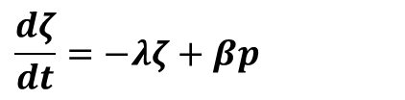
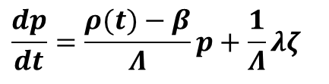
Sub-prompt critical w/ One-group kinetics equations
Review Prompt Jump Approximation
$$\frac{dp}{dt}=\frac{ρ(t)−β}{Λ}p+\frac{1}{Λ}λζ$$
$$\frac{dζ}{dt}=−λζ+βp$$
Method of Singular Perturbations

Slide 5
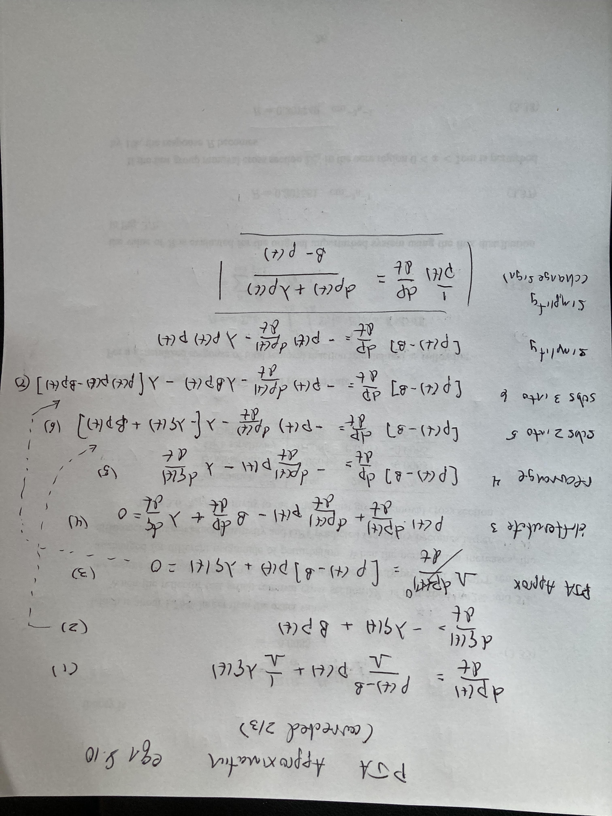
Derivation of PJA (Eqn. 8.10)
Eqn. 8.10

Slide 6
Derivation of PJA (Eqn. 8.10)
Singular Perturbation

Slide 7
Analysis of Eq. 8.10

Slide 8
Analysis of Eq. 8.10 (cont.)

Slide 9
Analysis of Eq. 8.10 (cont.)

Slide 10
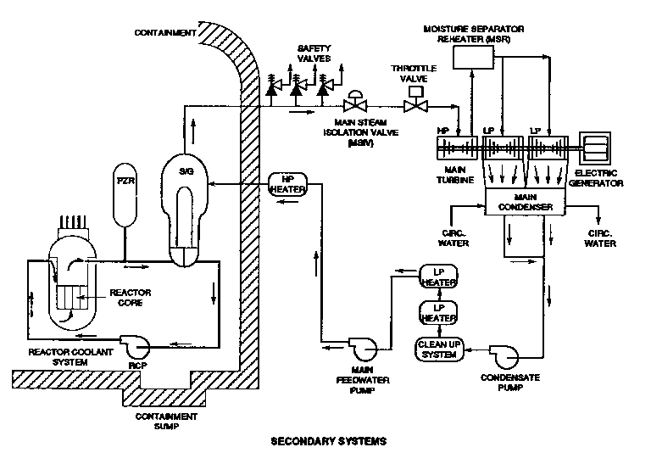
Nuclear Reactor Transient Analysis: PWR Main Steam Line Break
PWR Plant
Schematic
Notes:
10

Slide 11
Main Steam Line Break Transient: Core Coolant Temperature
Density
Doppler
Total
Control Rod
Notes:
11

Slide 12
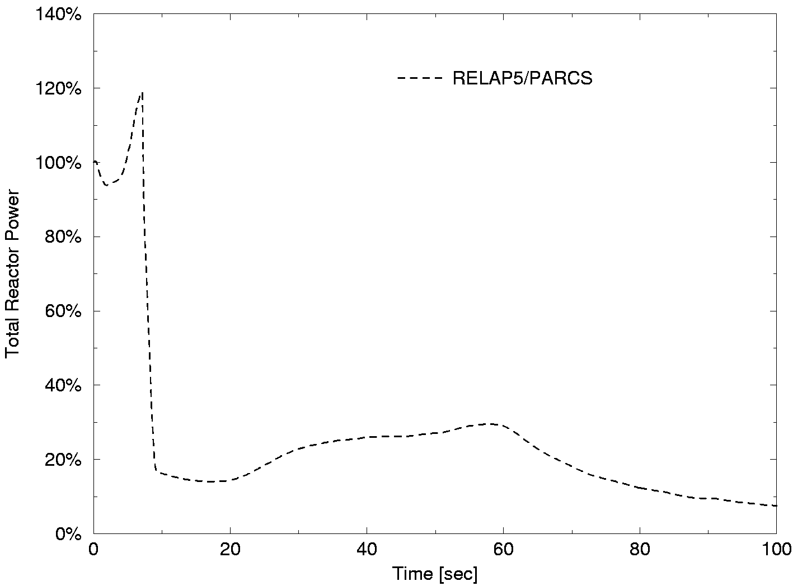
Main Steam Line Break Analysis: Core Average Power
Density
Doppler
Total
Control Rod
Notes:
12

Slide 13
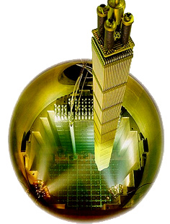
MSLB: Core 3D Neutronics Model
reflector
assembly
14
19
8
15
9
2
7
13
3
1
16
10
4
6
12
18
5
11
neutronic fuel
assembly
stuck rod
location
17
Notes:
13

Slide 14
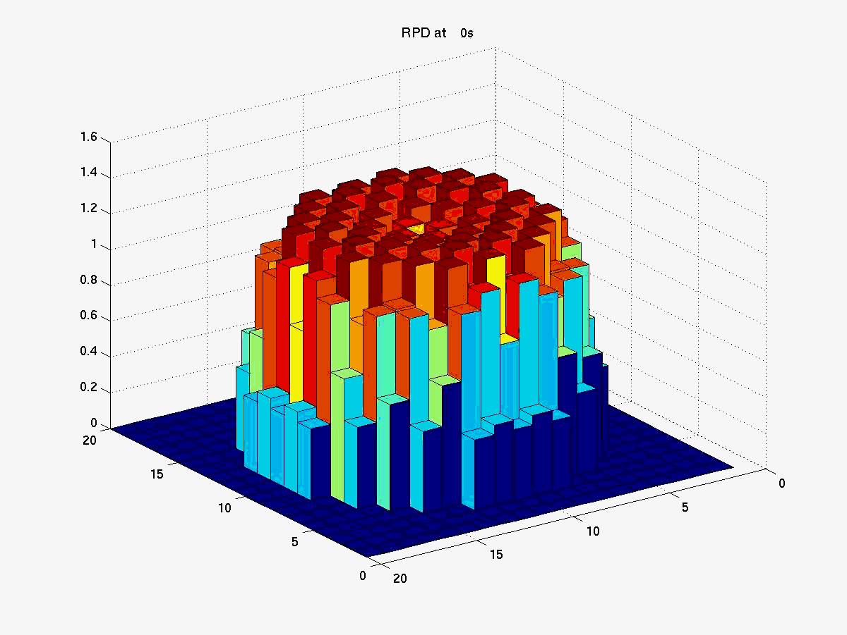
Three-Dimensional Analysis Main Steam Line Break
Initial Steady-State
Notes:
14

Slide 15
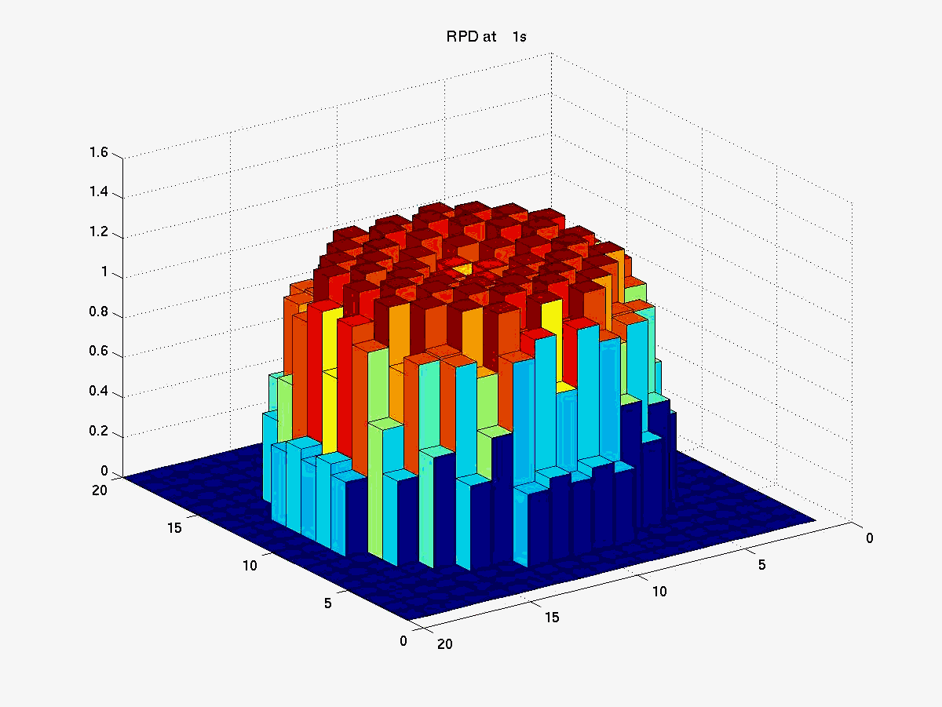
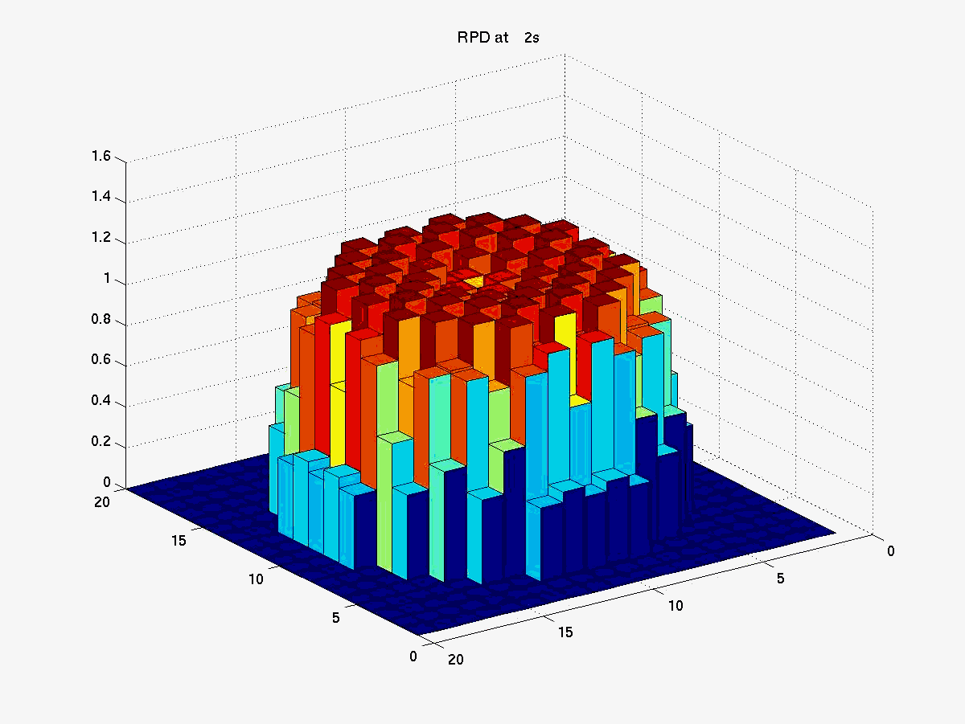

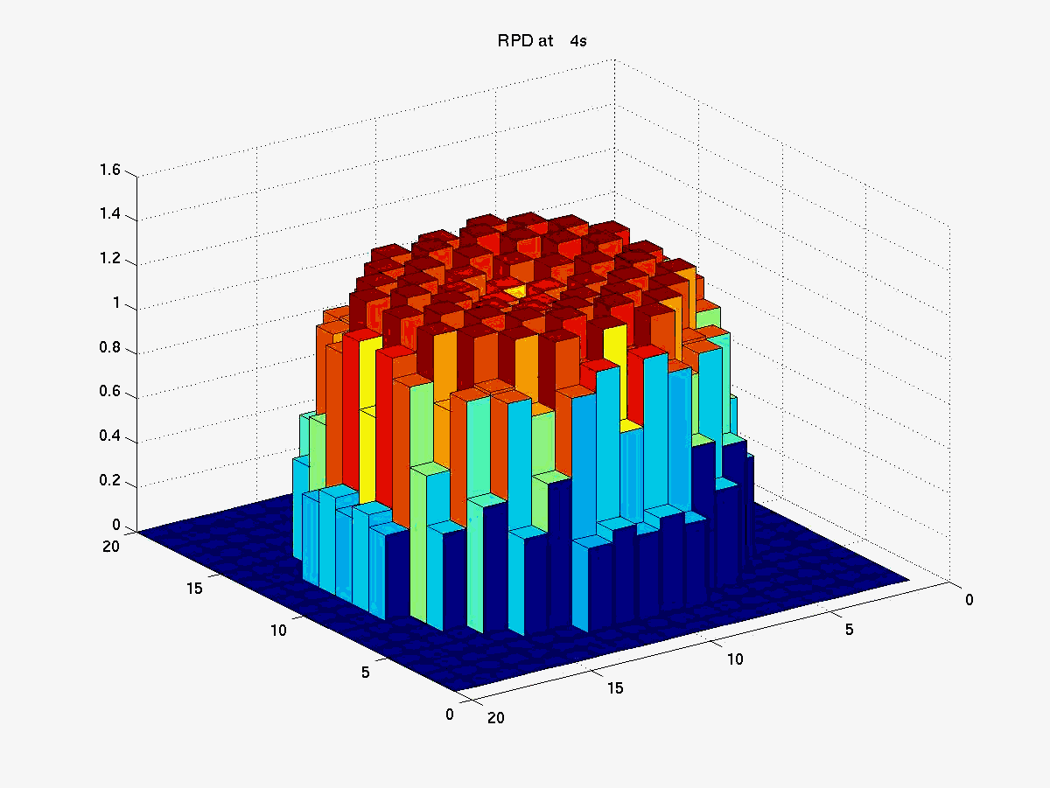
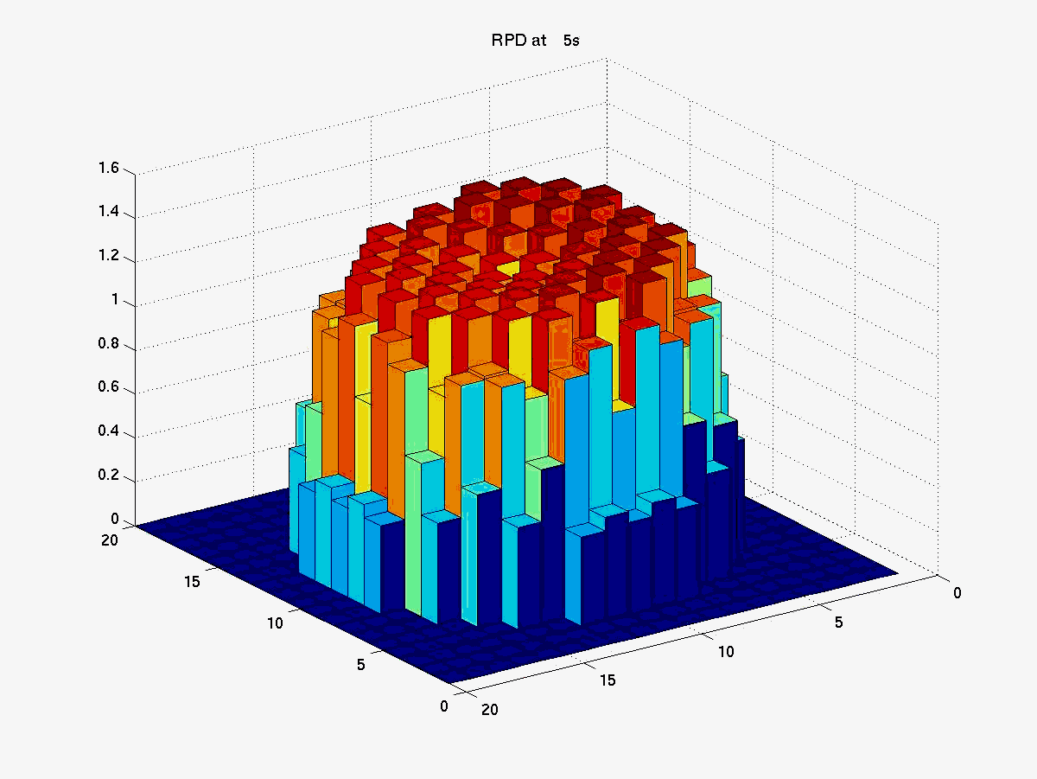
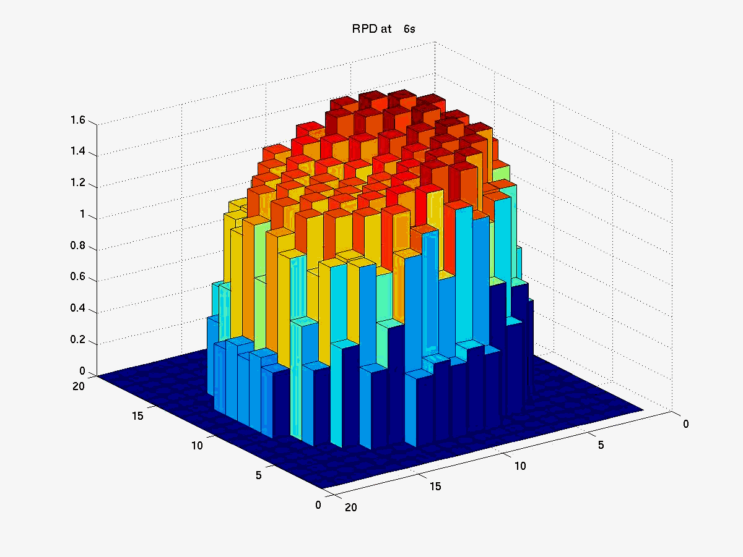
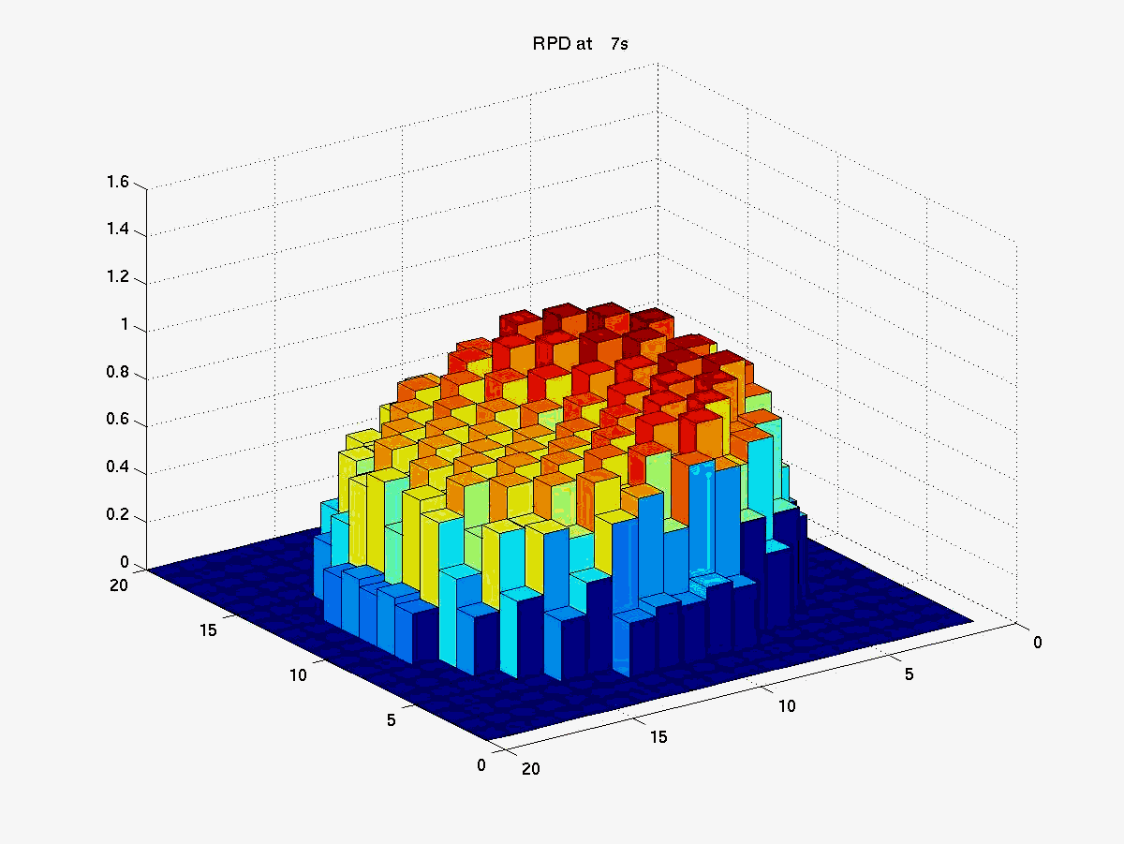
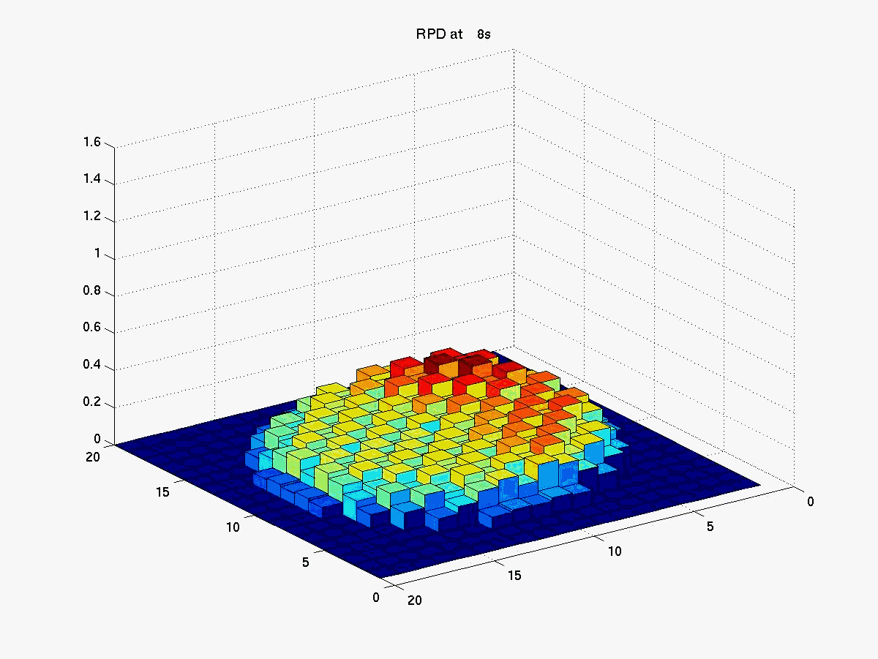
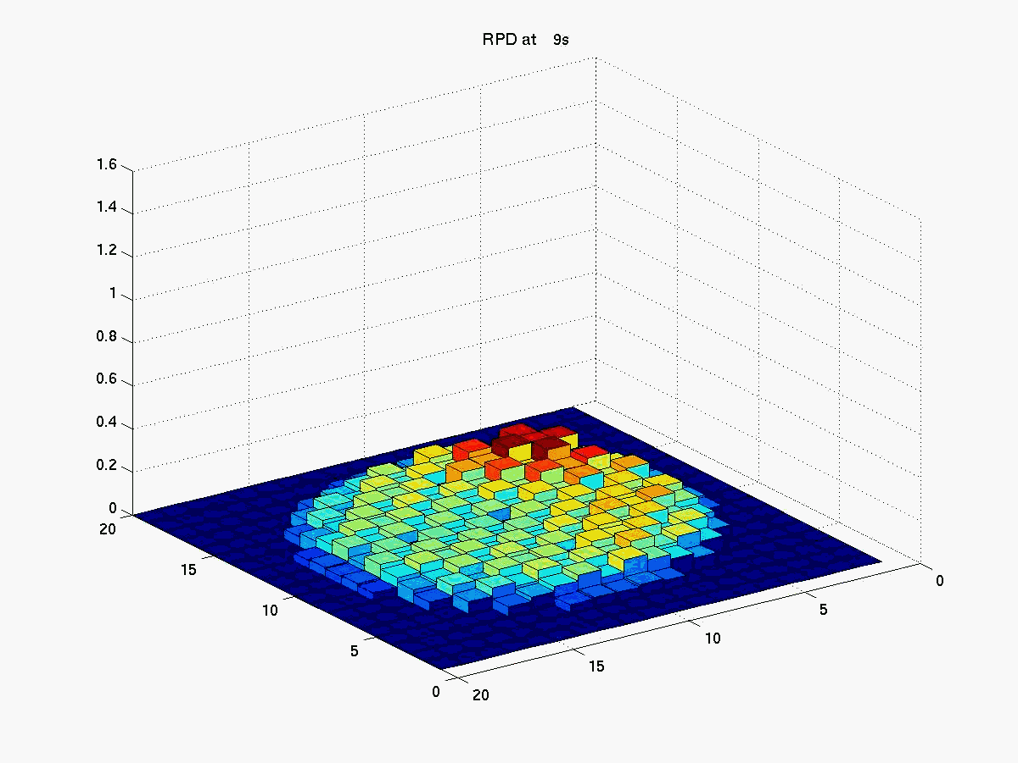
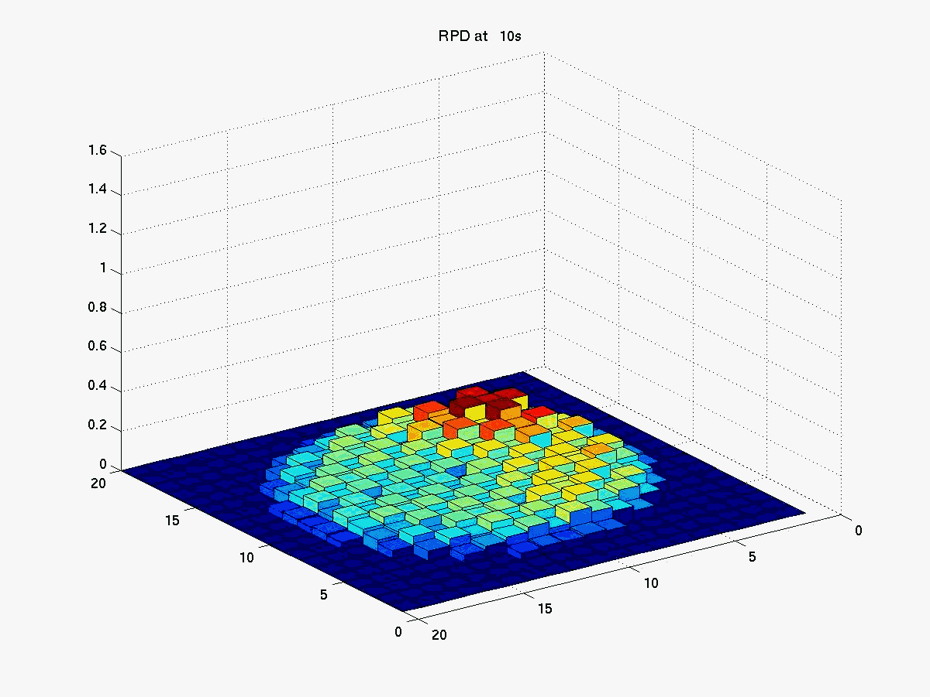
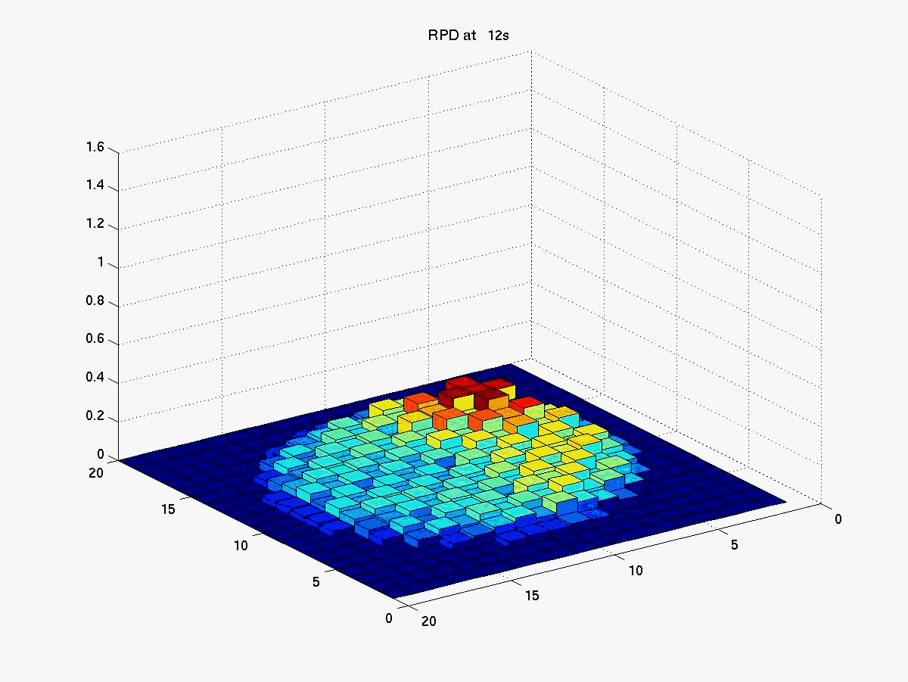
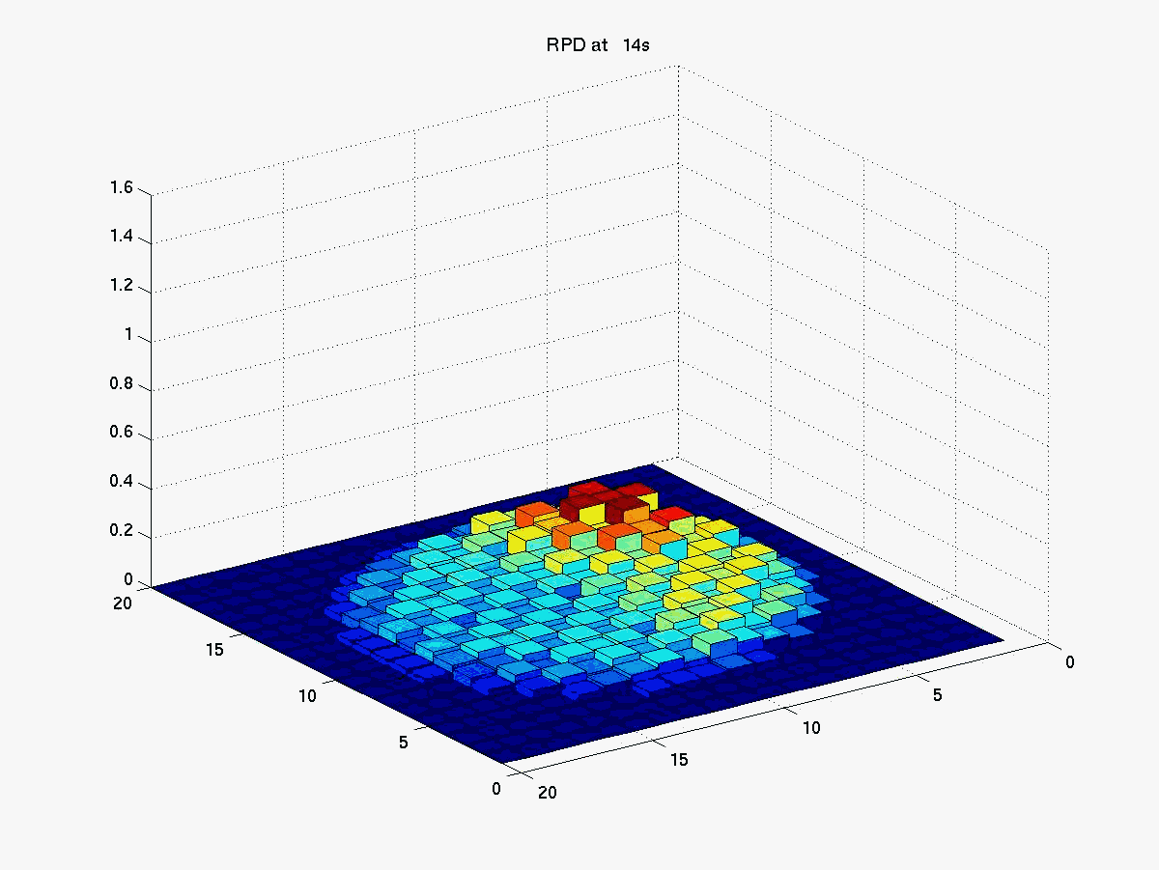
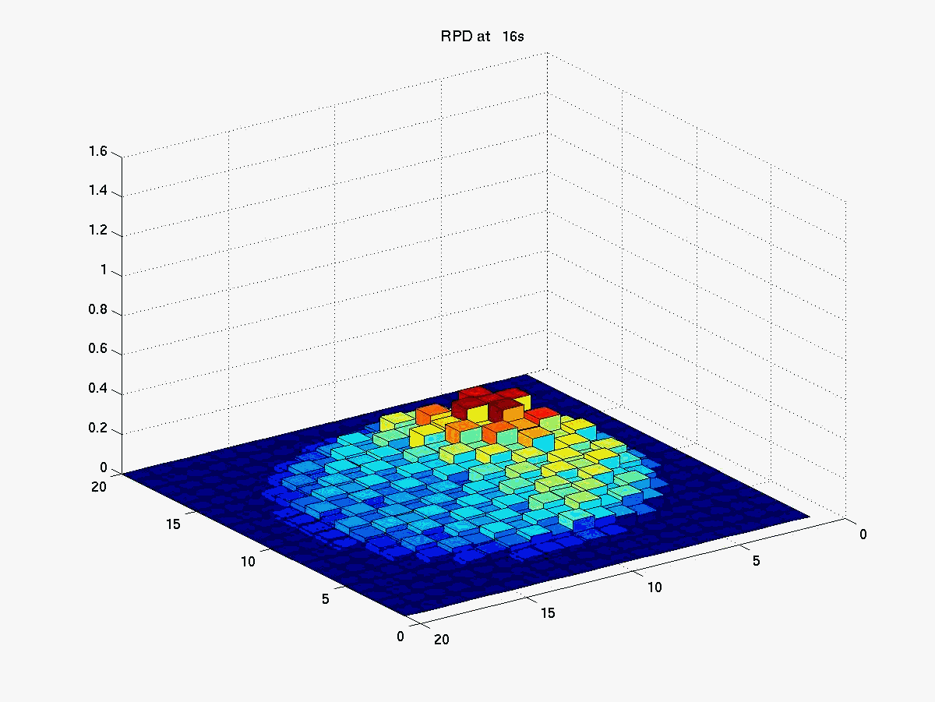
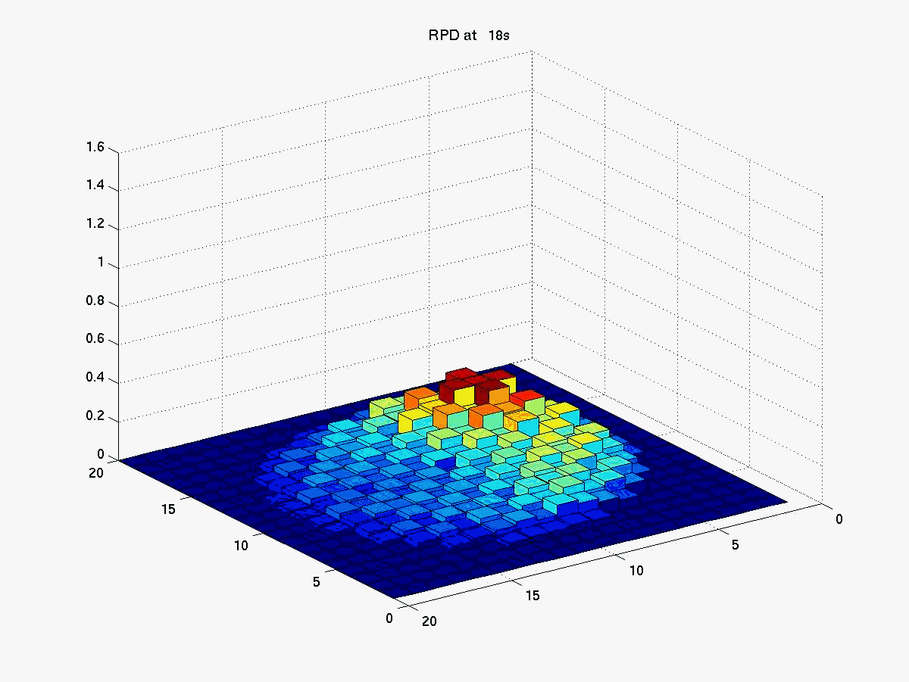
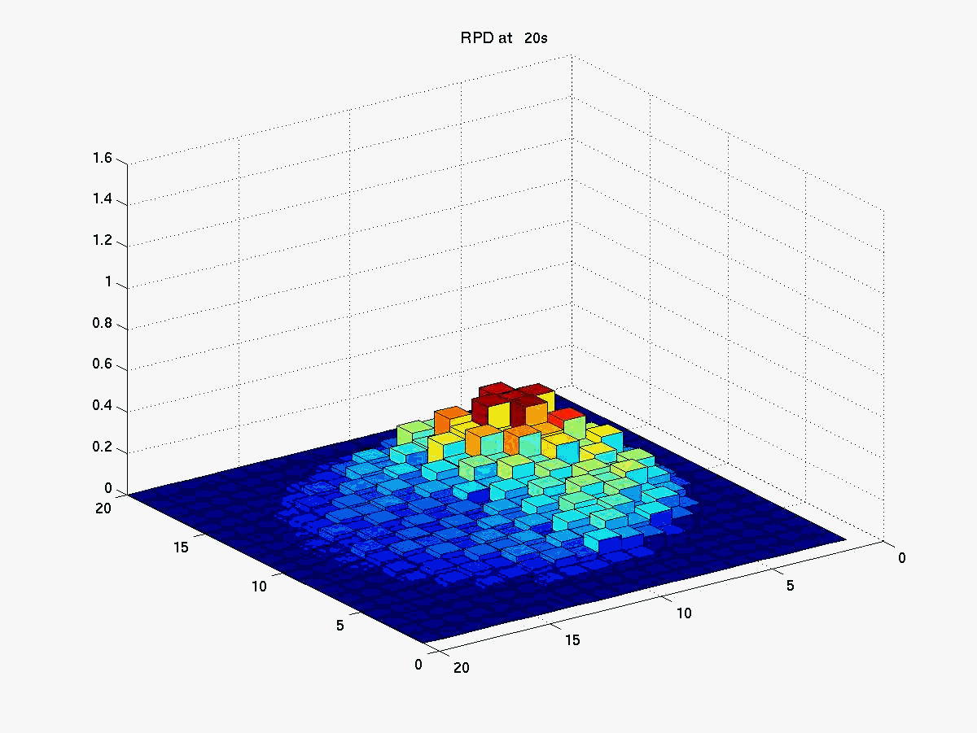
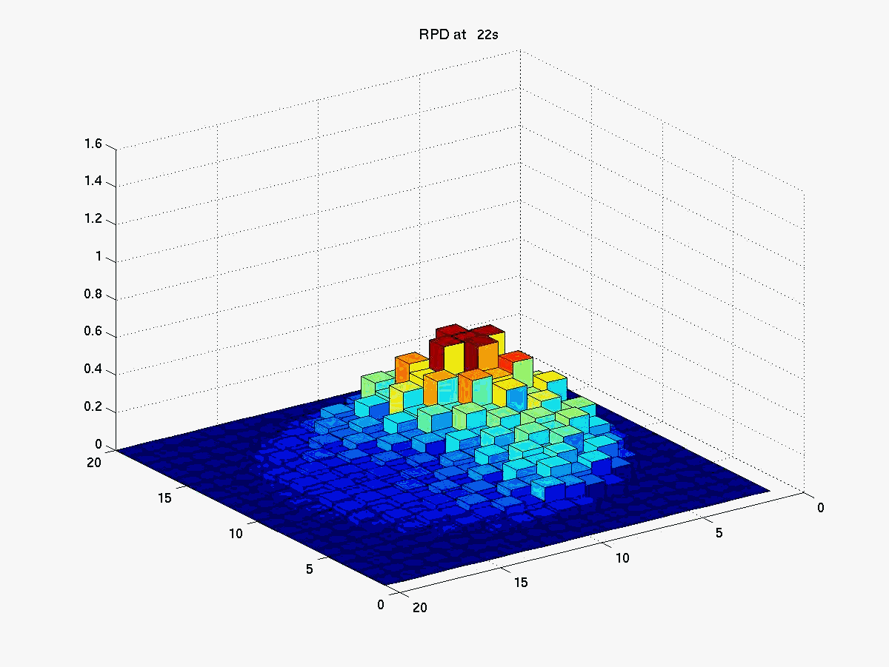
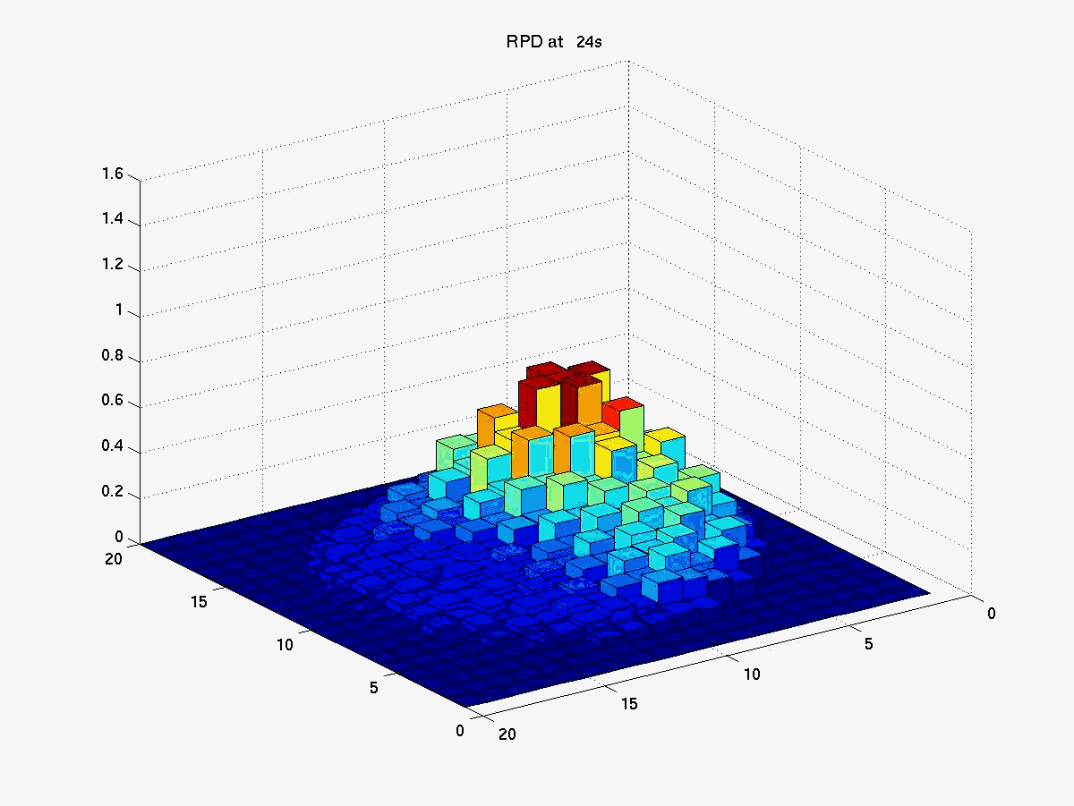
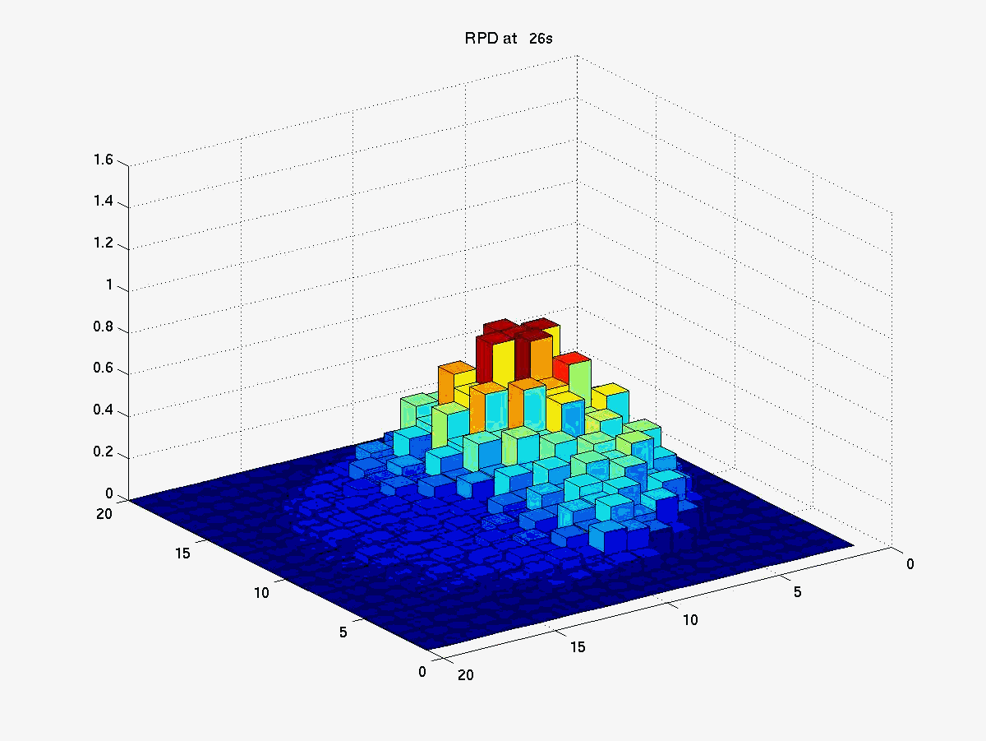
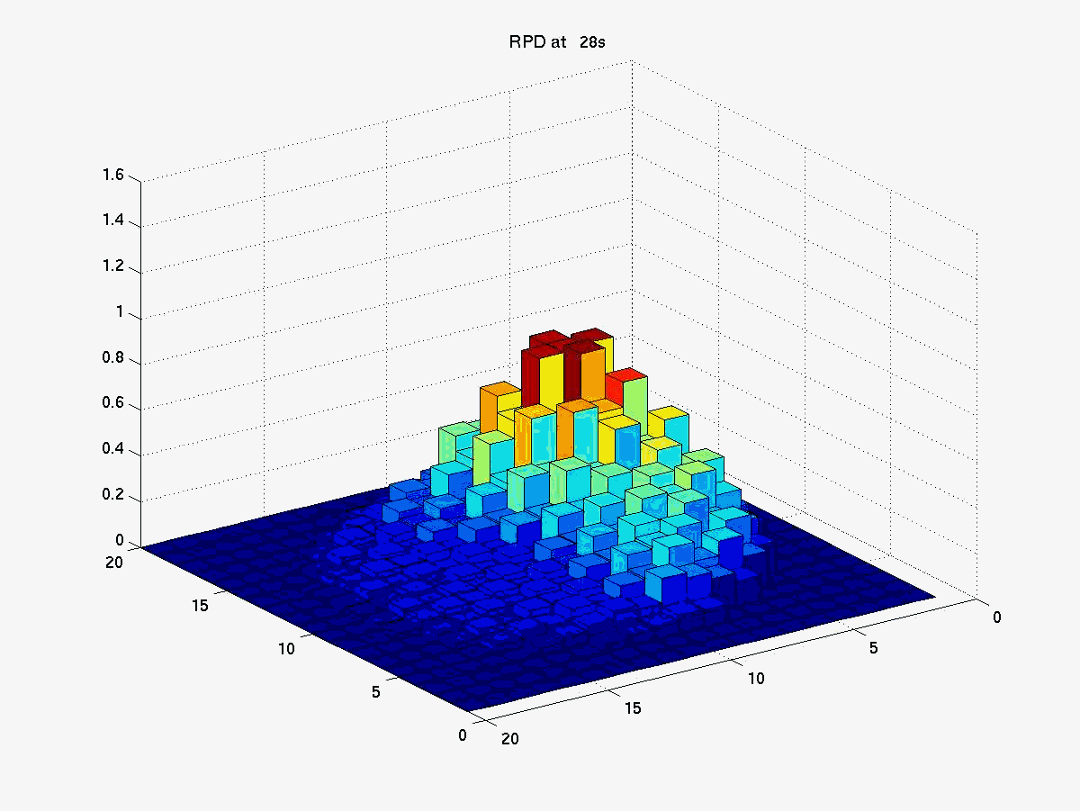
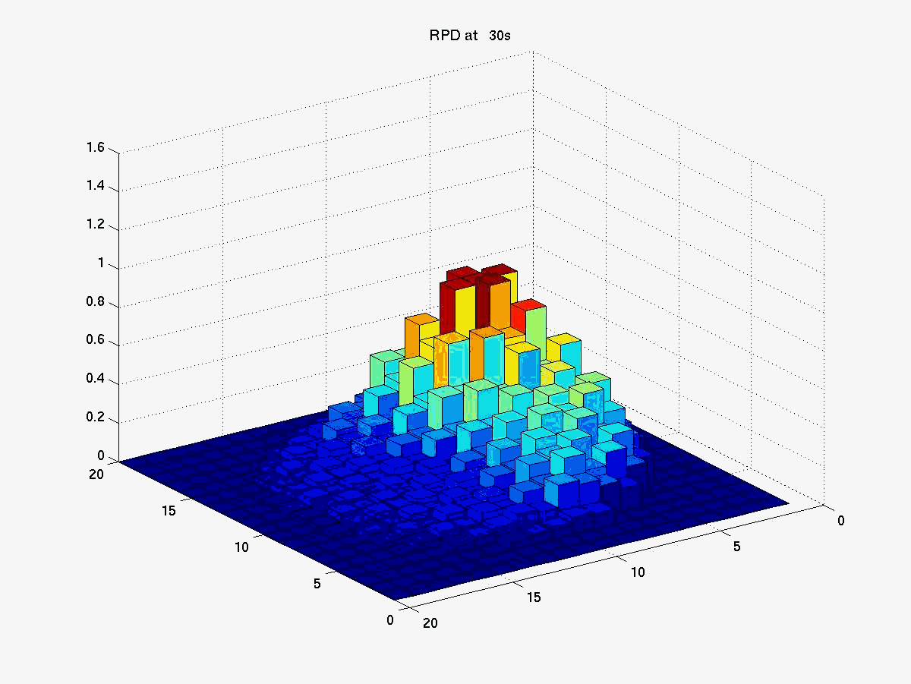
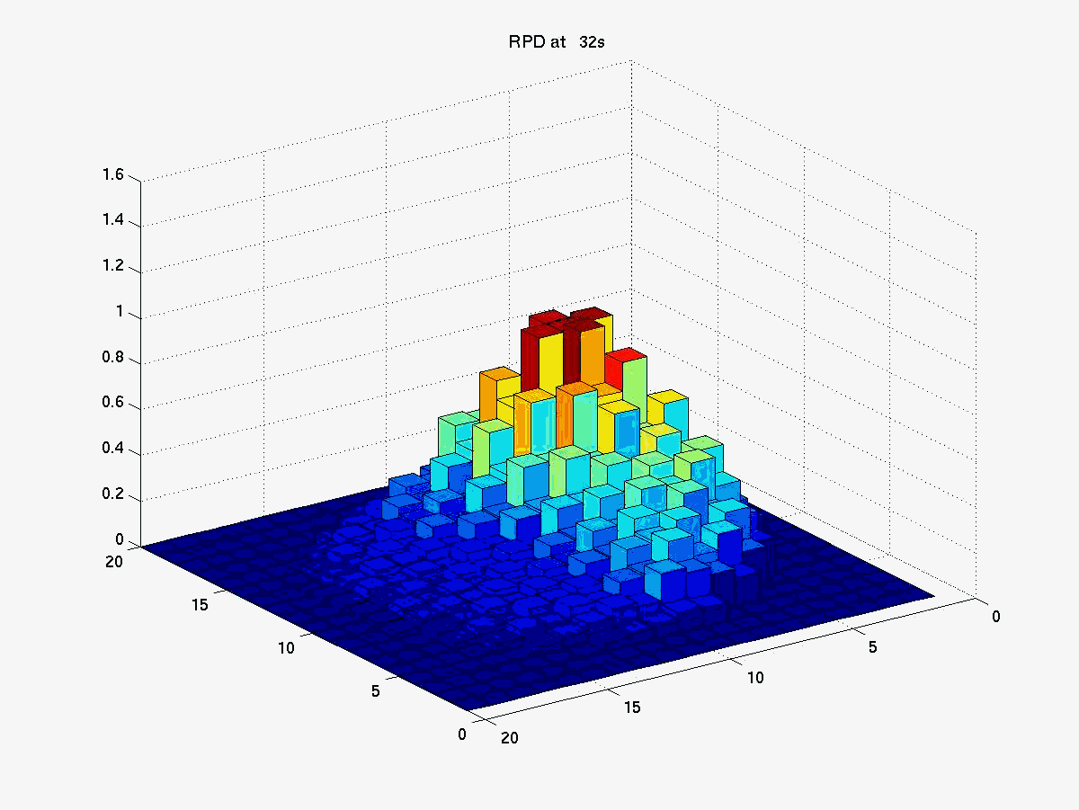





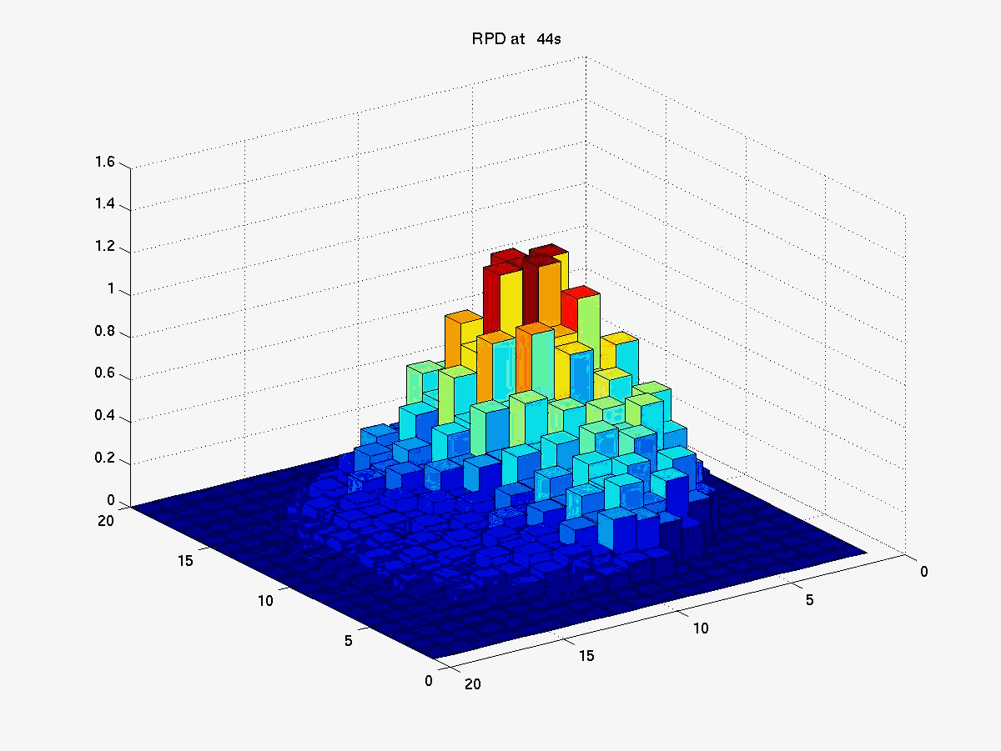

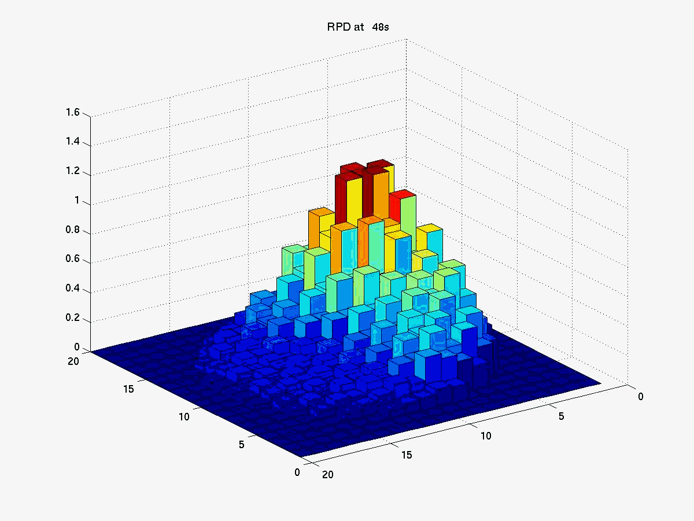








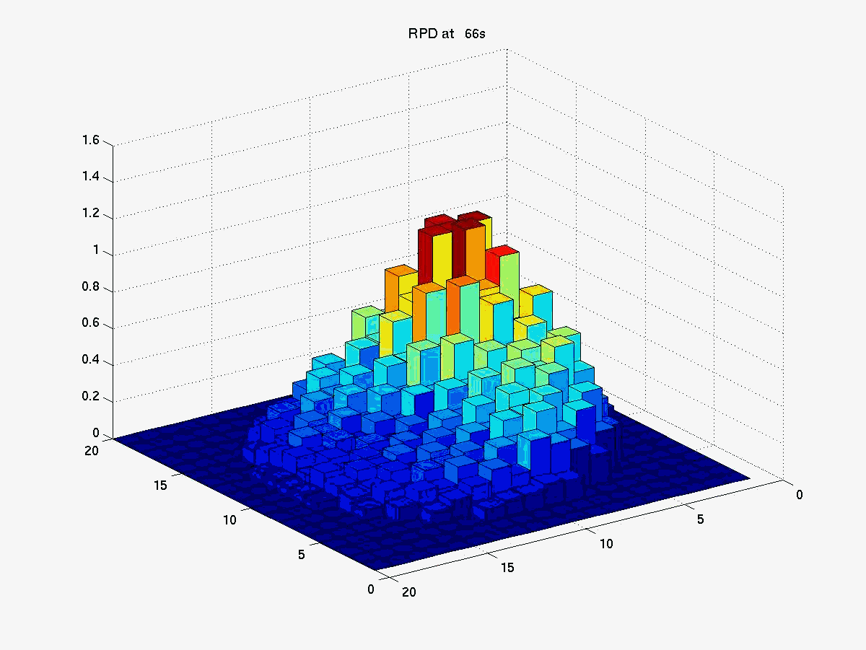


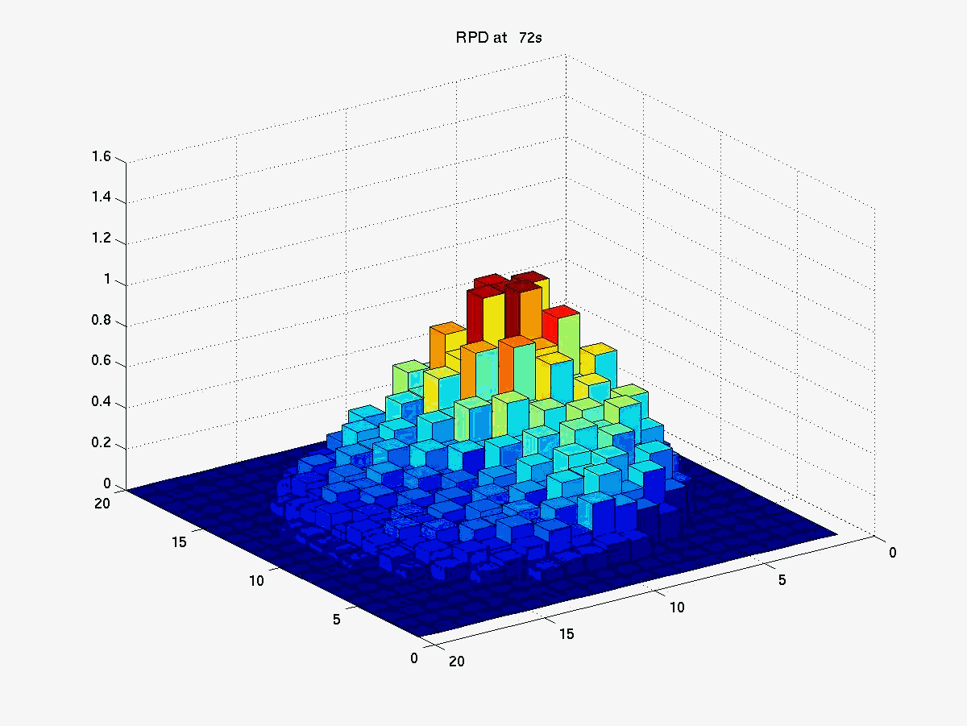
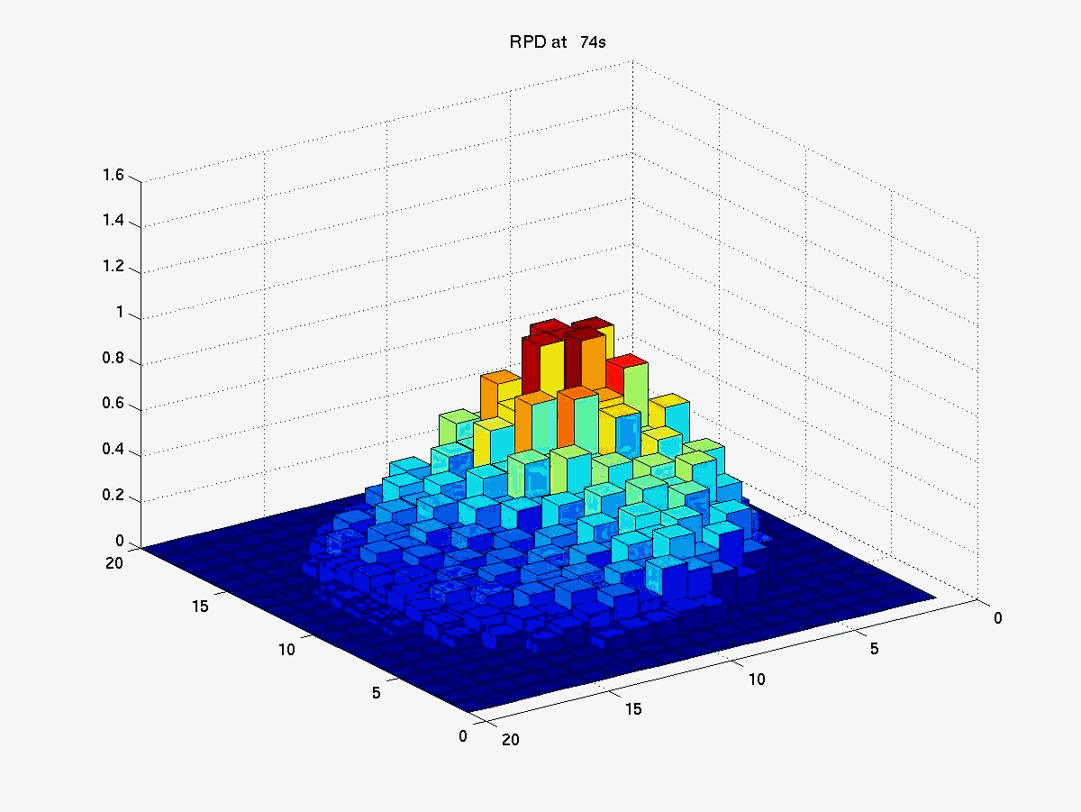



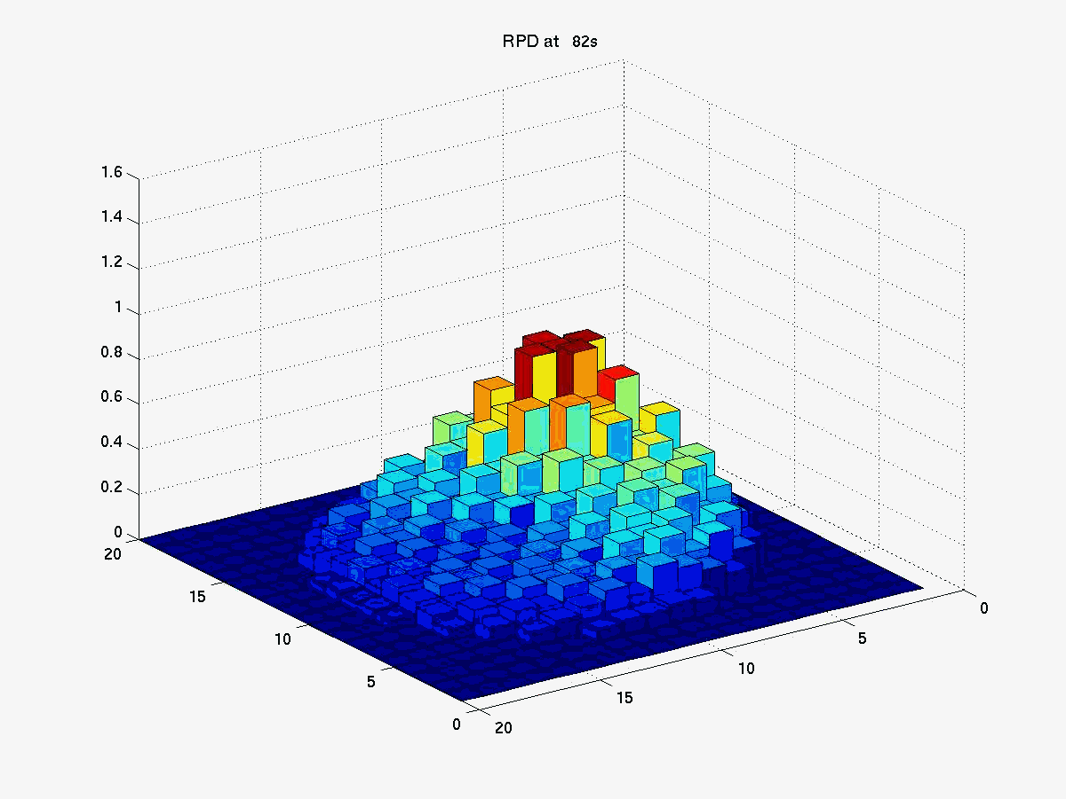
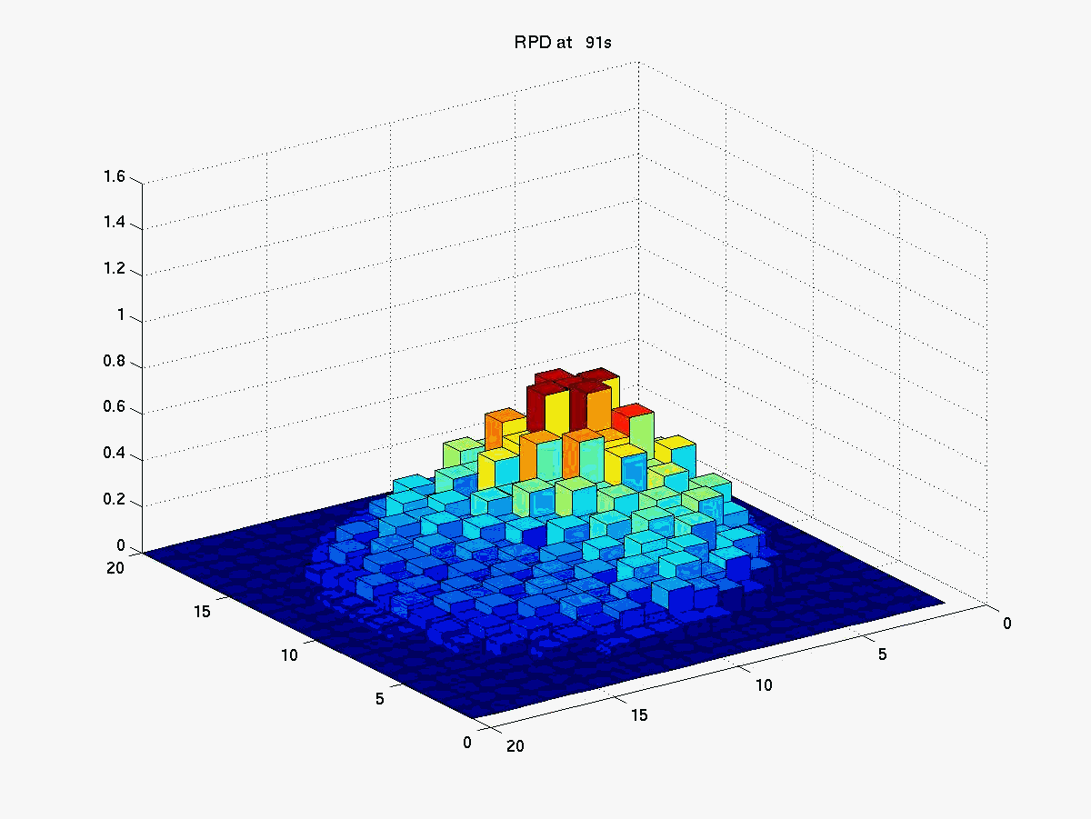
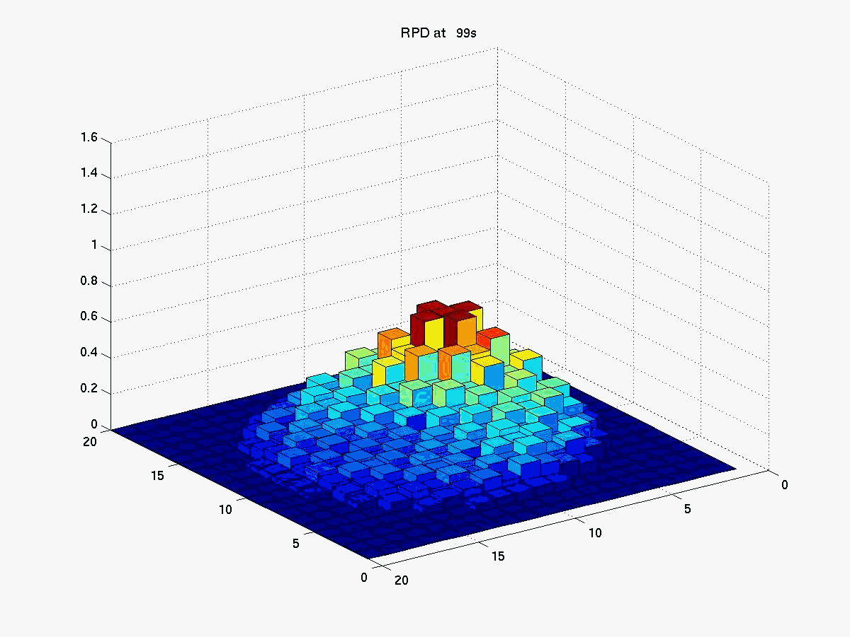
MSLB Transient Analysis
Radial Power Evolution
Notes:
15

Slide 16
PJA Analytic Solution

Slide 17
PJA Analytic Solution

Slide 18
PJA Analytic Solution – Generalized Asymmetric Ramp

Slide 19
PJA Analytic Solution - Generalized

Slide 20
PJA Analytic Solution - Generalized

Slide 21
Sec 8.2 PJA for Superprompt

Slide 22
“Big Picture”
Ch 5 Exact Point Kinetics (Eq. Eq. 5.34)
w/ assumptions -> Point Reactor Model
Ch 6
Simplify Delayed Neutron Source -> one group delayed neutrons
Application to CONSTANT reactivity insertion (ie NO FEEDBACK)
SOLUTION w/ one group delayed neutronics … Eq. 6.109
Superprompt
Subprompt
Ch 8 Time-dependent Reactivity -> Subprompt (e.g. MSLB)
Ch 10 Time-dependent Reactivity w/ Feedback
10.1 Measurement of doppler coefficient in SEFOR using subprompt
10.2 Superprompt RIA transient … e.g. Control Rod Ejection

